Slide 1
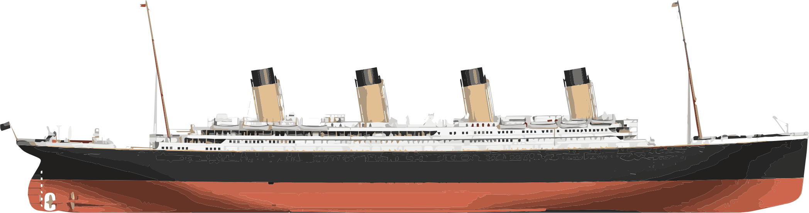
Predicting Titanic Survival
With
Machine Learning
Omari Emmanuel, Chris Smith & Hanna Nguyen
MAT 340 FINAL PROJECT

Slide 2
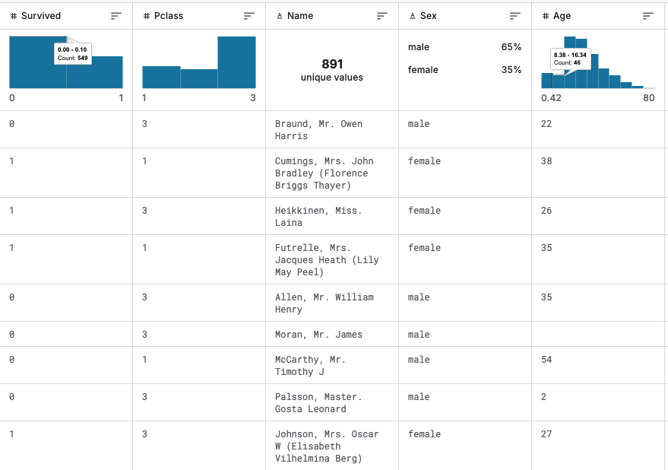
Project Goal & Dataset Overview
Use machine learning to predict passenger survival on the Titanic
Dataset sourced from Kaggle: 891 rows, 12 columns (train set)
Task: build, evaluate, and compare classification models
Outcome: select the most accurate and interpretable model

Slide 3
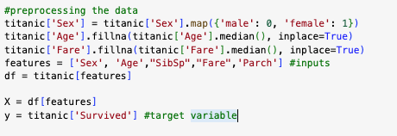
Data Cleaning & Feature Engineering
Merged train and test sets on PassengerId
Encoded Sex: male → 0, female → 1
Filled missing Age and Fare with median
Selected features:
Sex, Age, SibSp, Parch, Fare

Slide 4
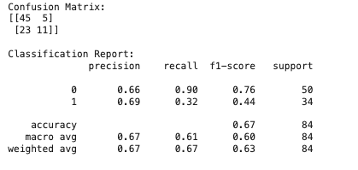
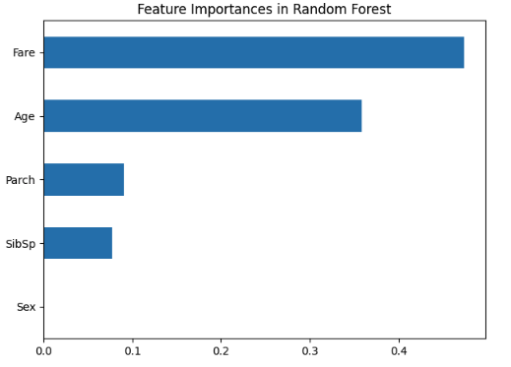
Random Forest (Baseline Model)
First attempt using n_estimators=500, max_depth=10, max_leaf_nodes=100
Accuracy: 67%, Survivor Recall: 32%
High precision for Class 0 (non-survivors),but very low recall for Class 1 (survivors)
Early sign that default parameters were underfitting the data
Features in our Random Forest : Sex, Age, SibSp, Fare, Parch

Slide 5
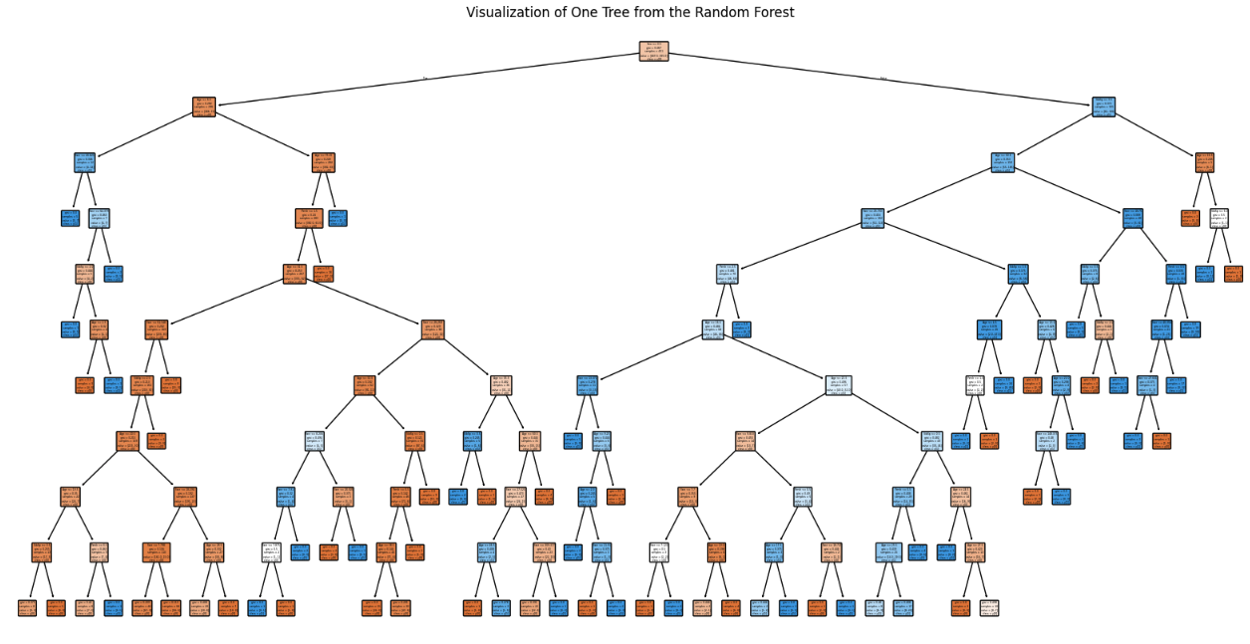
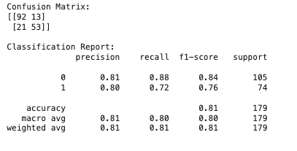
Random Forest (Final Tuned Model)
Used GridSearchCV to test combinations of n_estimators and max_depth
Final params: n_estimators=20, max_depth=200, max_leaf_nodes=100
Accuracy: 81%, Survivor Recall: 72%
Balanced performance across both classes and features

Slide 6
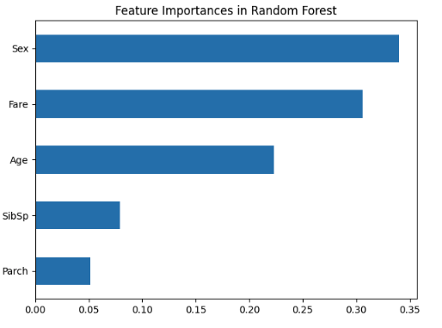
Feature Importance in Random Forest
Top features ranked: Sex, Fare, Age, SibSp, Parch
Sex had the most impact (reflecting lifeboat priority)
Fare and Age captured economic and vulnerability patterns

Slide 7
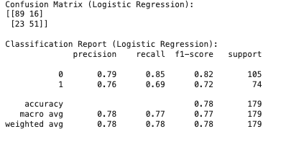
Logistic Regression Performance
Simple, interpretable baseline model
Accuracy: 78%
Survivor Recall: 69%
Performed well but limited by linear assumptions

Slide 8
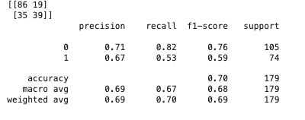
K-Nearest Neighbors (KNN) Performance
Instance-based learner using distance
Accuracy: 70%
Survivor Recall: 53%
Underperformed — struggled with non-linear boundaries and scaling sensitivity

Slide 9
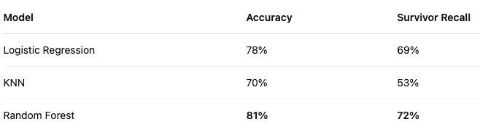
Model Comparison Summary
Logistic Regression: 78% accuracy, solid benchmark
KNN: 70% accuracy, lower survivor detection
Random Forest (Tuned): 81% accuracy, 72% recall for survivors
Final model chosen: Random Forest, best balance of power and interpretability

Slide 10
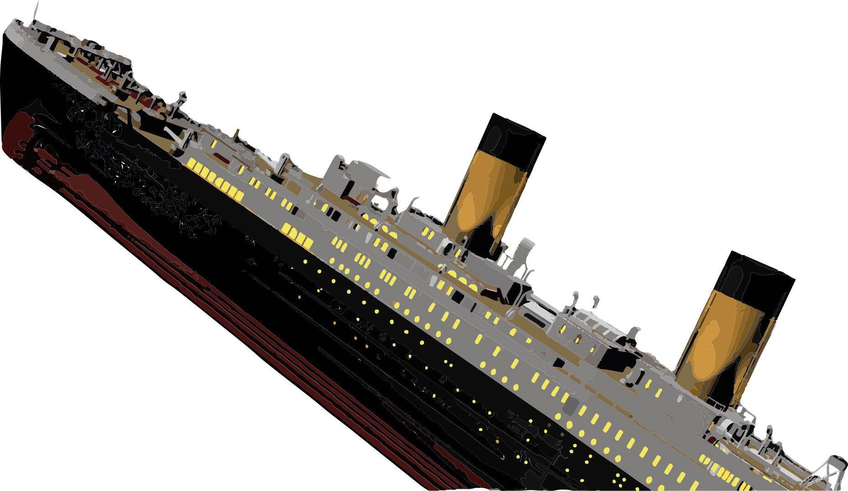
Reflections & Takeaways
Strengths:
High accuracy, interpretable output, strong preprocessing
Limitation:
Model could improve with feature engineering or ensemble voting
THANKS

